Slide 1
Recipe Book App
Visit site: https://ramandeep-recipe-book.netlify.app/
Source code: https://github.com/RamandeepChamba/recipe-book

Slide 2
Technologies
Using React Router.
Using useReducer + ContextAPI for state.
State is also being passed around via search params in url.
For styling, using Styled Components.
Supabase: to store recipe images.

Slide 3
Routes
Using AppLayout component for all routes.
Has header (search bar and add recipe button)
Has main for route content.
“/”:
Shows header from AppLayout.
Shows recipes with pagination (if any).
Shows filtered recipes if there are filters in the url.

Slide 4
“/addRecipe”:
Shows header.
Shows add recipe form.
“/recipe/:id”:
Shows header.
Shows specific recipe’s details.

Slide 5
File Structure
/src: has all the source code.
/src/contexts: contexts of our app.
/src/features/recipe: all components related to recipe.
/src/pages: all components which are used as elements in our routes.
/src/services: all our api code. Has supabase client setup and all calls to supabase.

Slide 6
/src/styles: has global styles and mixins for Styled Components.
/src/ui: contains all generic reusable components like Button, Modal etc.
/src/utils: contains helper functions used throughout the app.
/src/App.jsx: defines routes and is our main component.

Slide 7
State
Our state lives in context (/src/contexts/RecipeProvider.jsx), and uses useReducer + ContextAPI.
We provide this context to our entire app.
Contains:
recipes: all recipes.
searchedRecipes: for optimization
searchQuery: preserves searchQuery
searchBy: preserves searchBy
filteredRecipes: preserves filtered recipes.
recipesToView: recipes that will be visible on page after applying pagination and filters. E.g. there may be 25 total filtered recipes after search but if page can show 10 max and we are on 2nd page then these will be array of 10 recipes from 10-19 of filtered ones.
Preserving recipes in local storage.

Slide 8
Reducer
Has two actions, filterRecipes and addRecipe.
filterRecipes:
Payload: { searchQuery, searchBy, pageFromUrl }
Case #1: If there is no searchQuery, it means there also is no searchBy, recipes are filtered by pagination.
Case #2: searchQuery and searchBy are same as previous, meaning the filtered recipes are same, only the page has changed, do not filter recipes again (optimization), just filter the already filtered recipes by page.

Slide 9
Case #3: searchQuery is there but is different or is searched for first time. SearchBy is:
keyword: filter in recipes which contains the keyword in it’s name or steps.
ingredients:
Should include all:
Syntax: searchQuery = 'tomato+onion+chicken'
Filter in recipes which have all the ingredients
Should include any:
Syntax: searchQuery = 'tomato, onion, chicken'
Filter in recipes which have atleast one of the ingredients.
addRecipe:
Payload: recipe object to be added.
Adds a recipe to all recipes.

Slide 10
How to use app

Slide 11
Add a recipe
Click "Add Recipe" button in header.
Will take you to "/addRecipe" route.
Will show add recipe form.
Provide name, finished image of recipe, ingredients and steps and submit.
Will add recipe, and redirect you to your newly added recipe's details page.

Slide 12
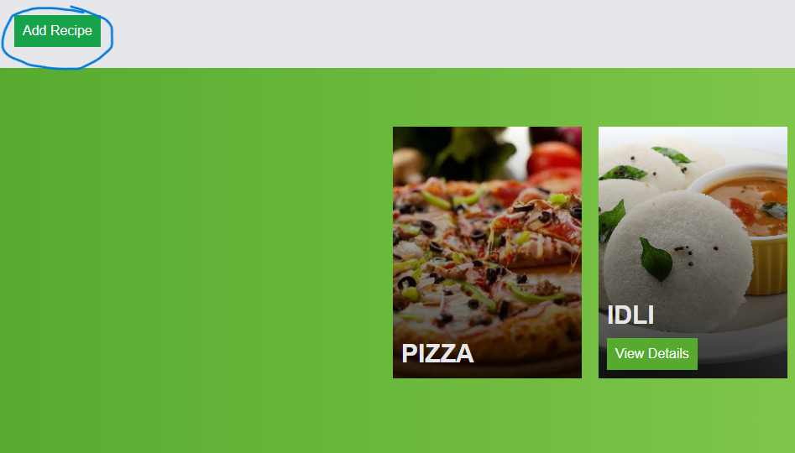
Click Add Recipe button

Slide 13
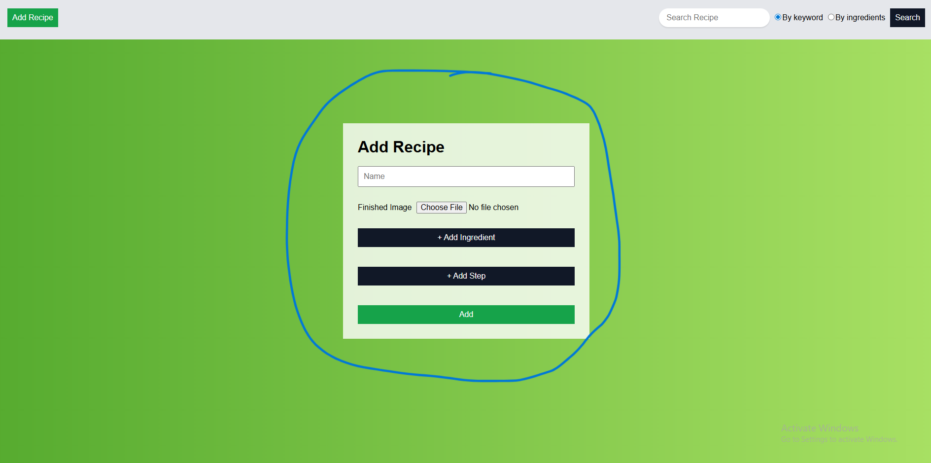
2. Will show add recipe form

Slide 14
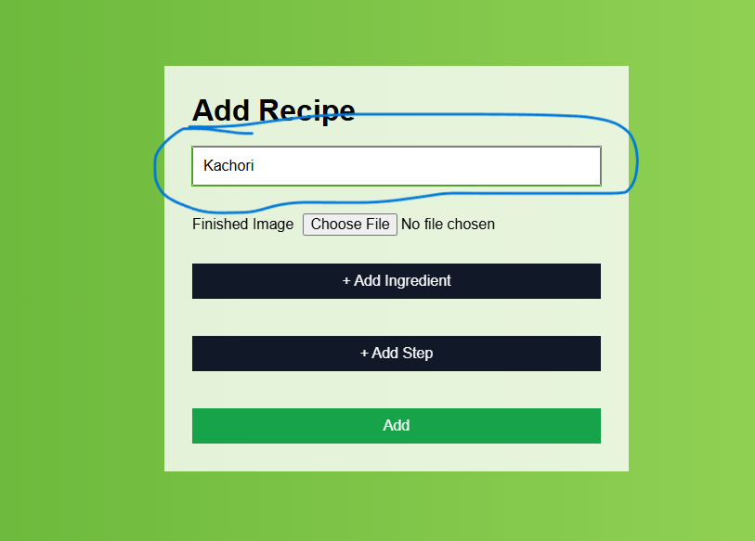
3. Enter recipe's name

Slide 15
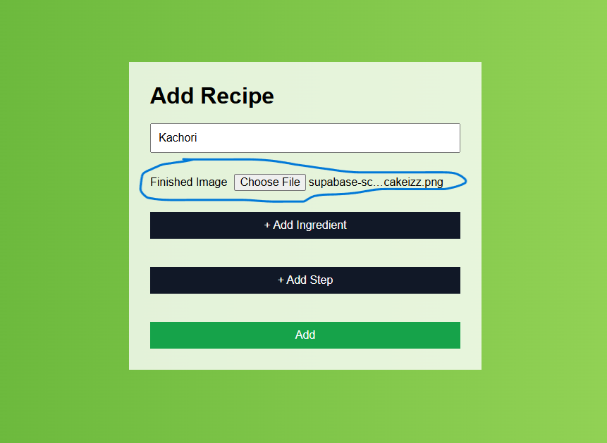
4. Choose recipe's finished image

Slide 16
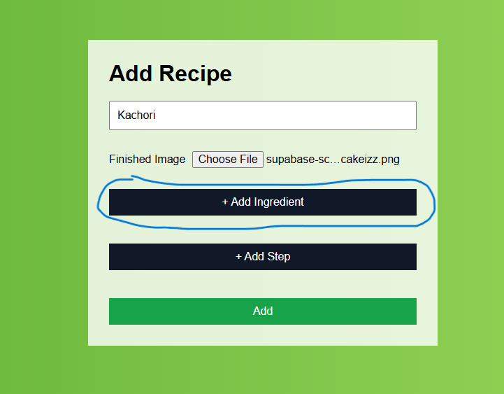
5. Add an ingredient

Slide 17
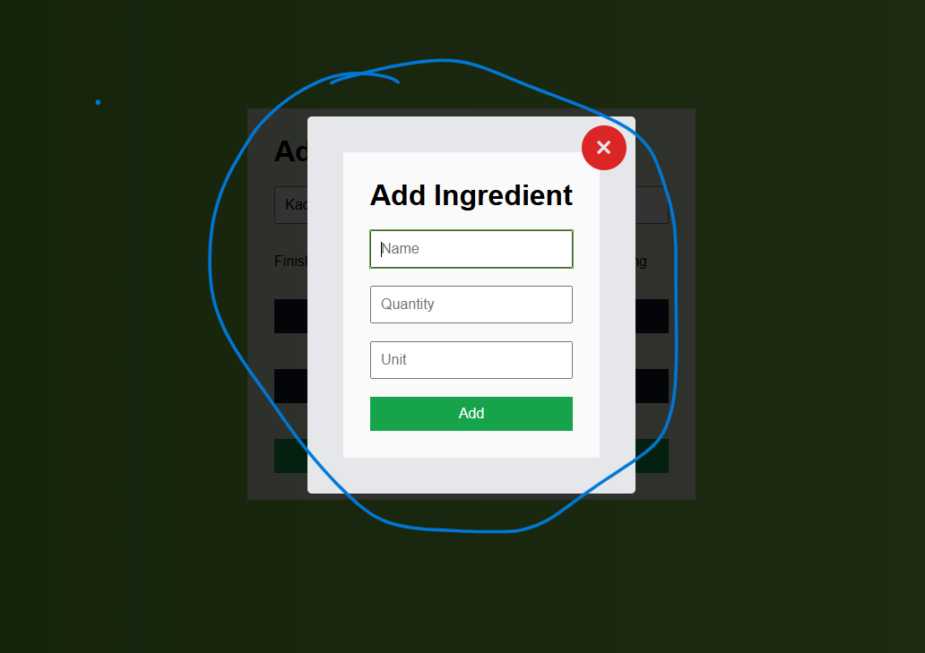

Slide 18
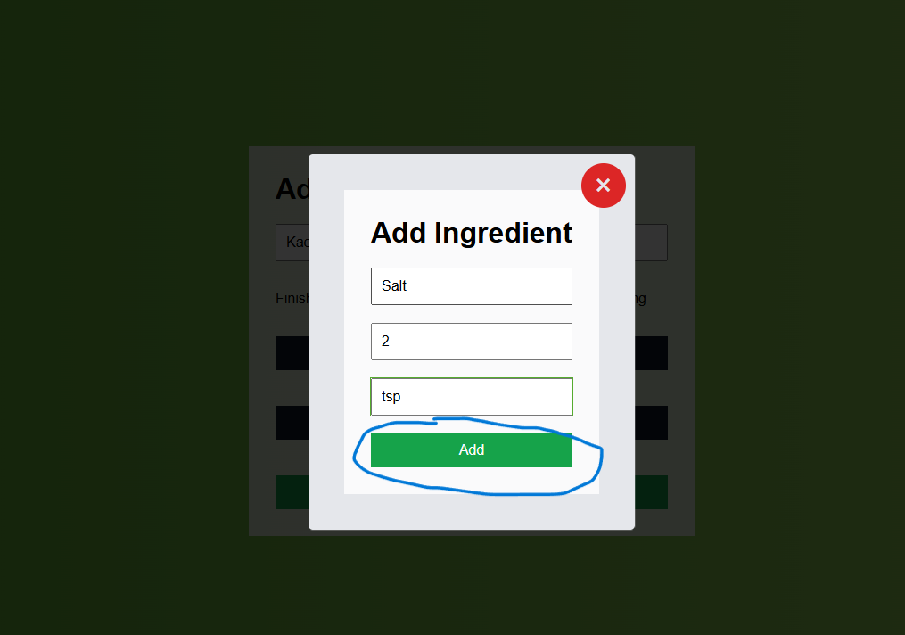

Slide 19
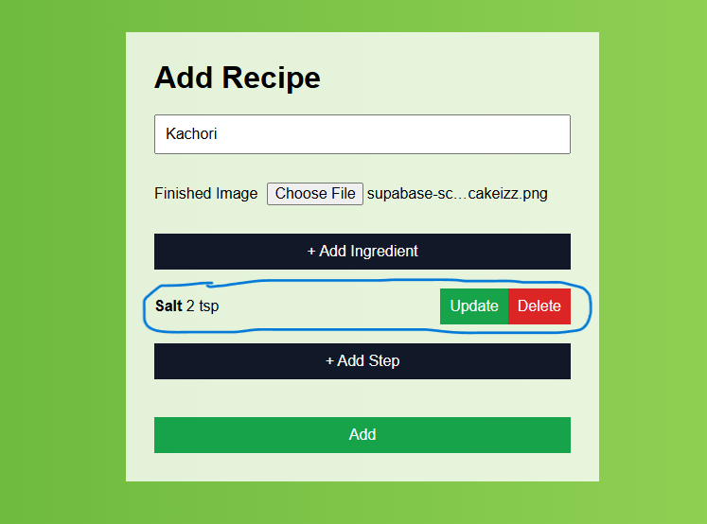

Slide 20
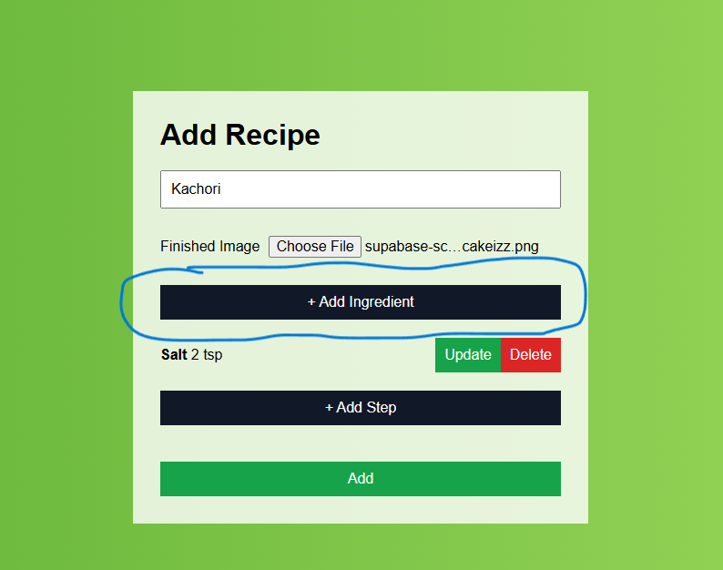
Can add more ingredients

Slide 21
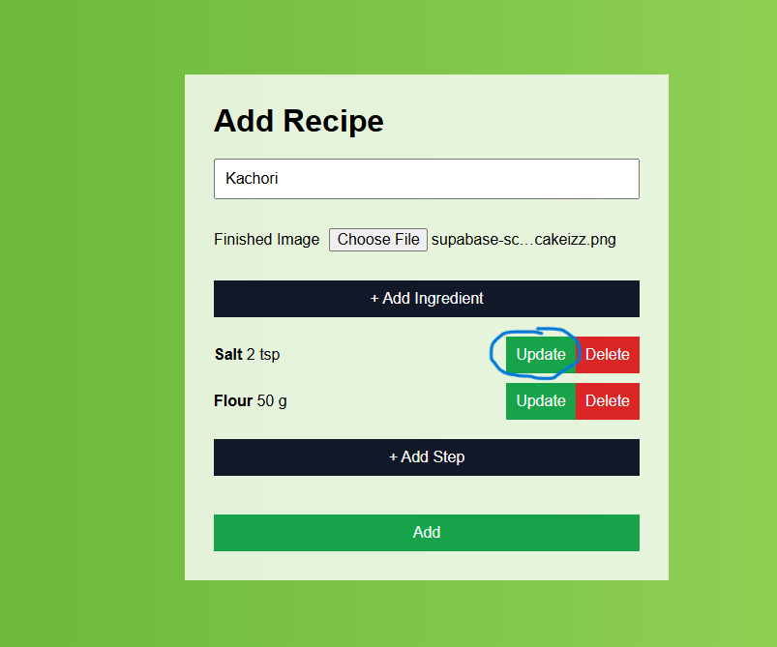
5.a. Update an ingredient

Slide 22
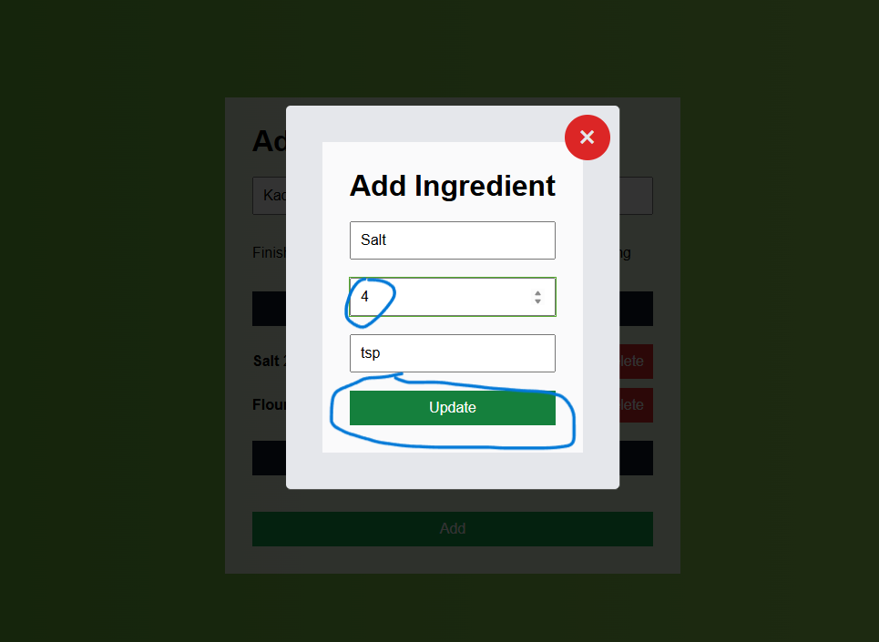

Slide 23
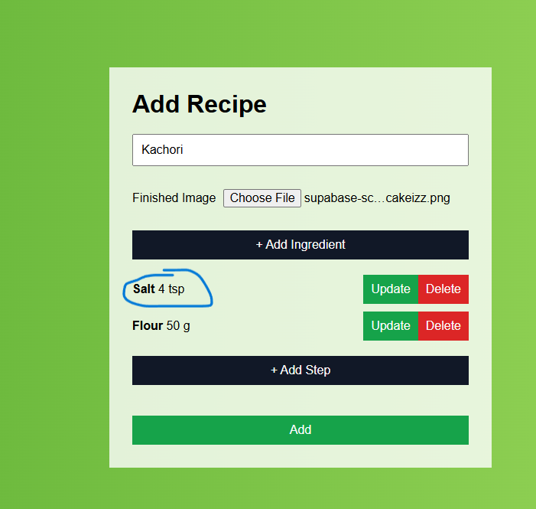

Slide 24
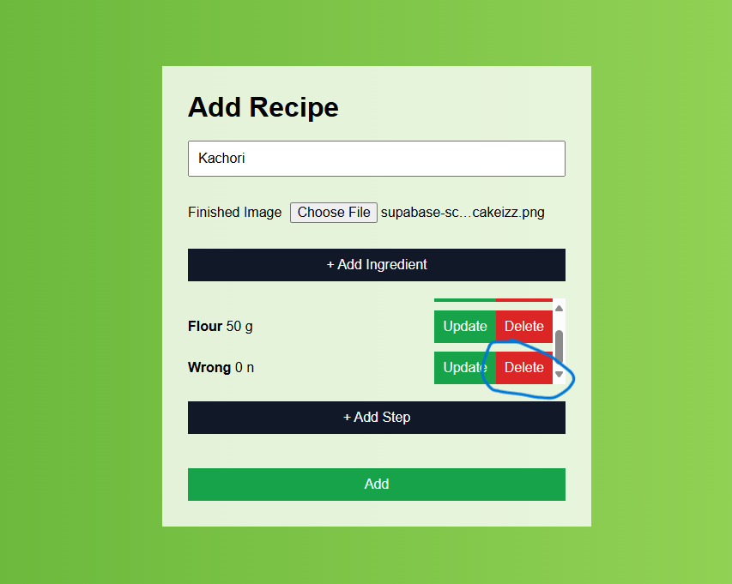
5.b. Delete an ingredient

Slide 25
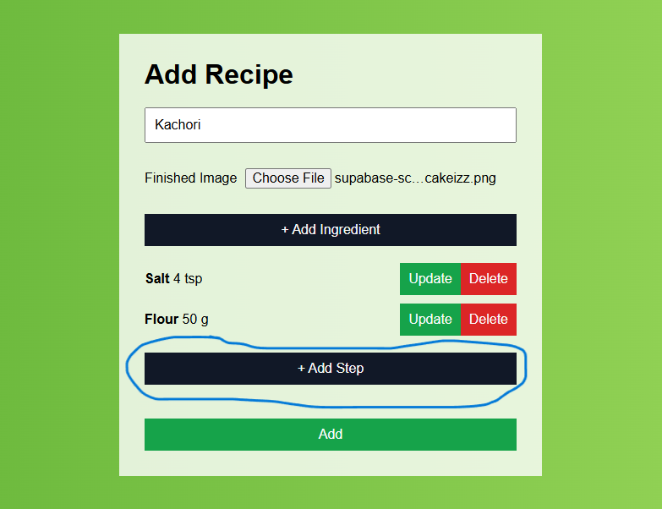
6. Add a step

Slide 26
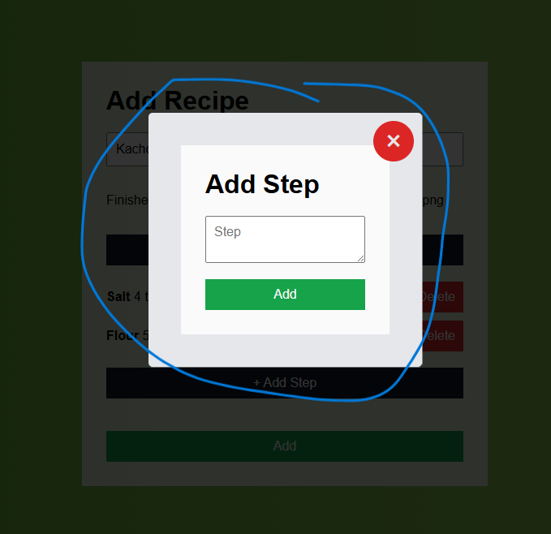

Slide 27
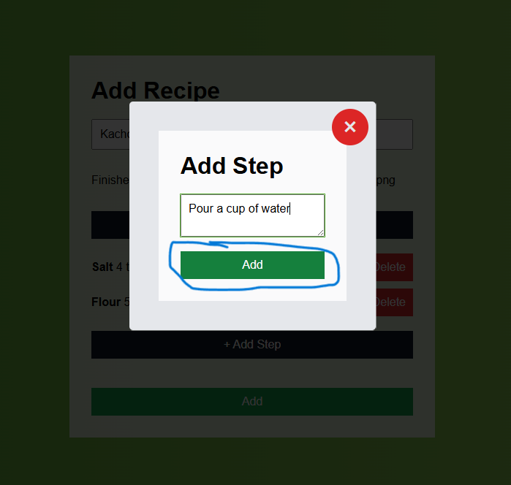

Slide 28
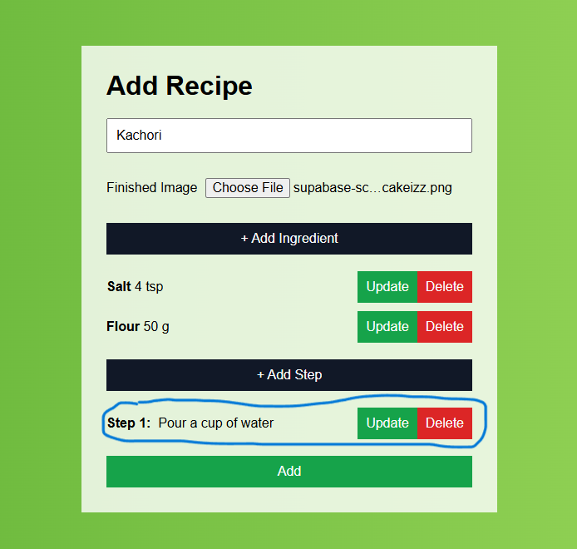

Slide 29
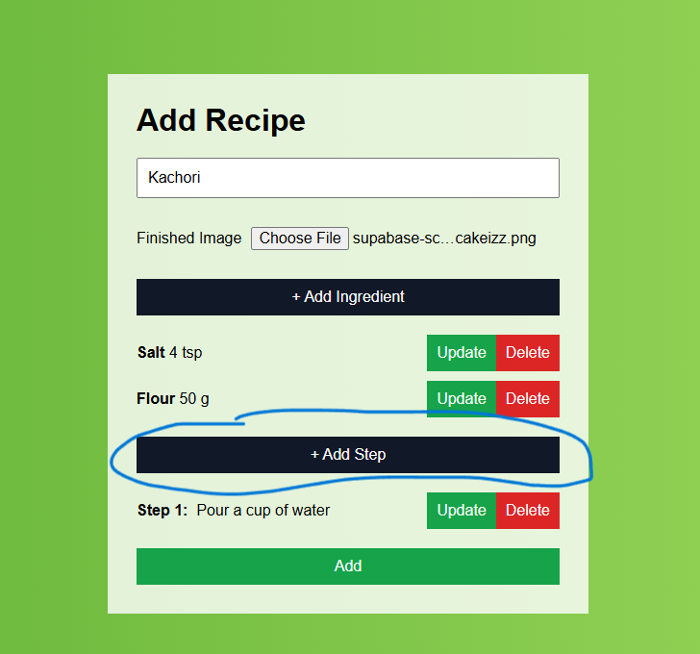
Can add more steps

Slide 30
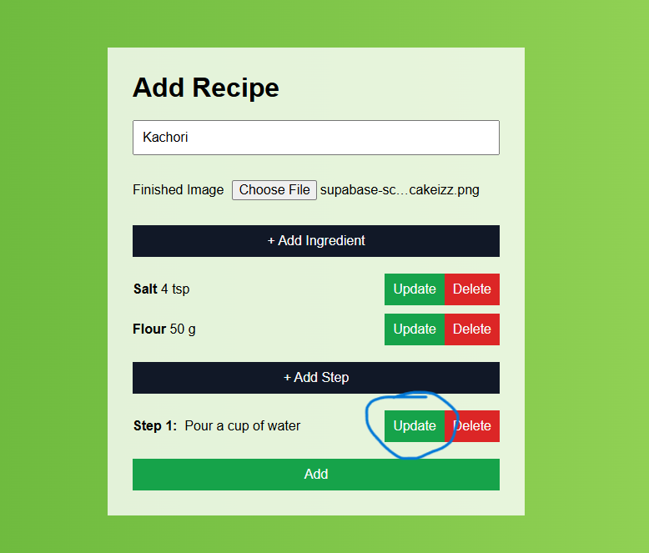
6.a. Update a step

Slide 31
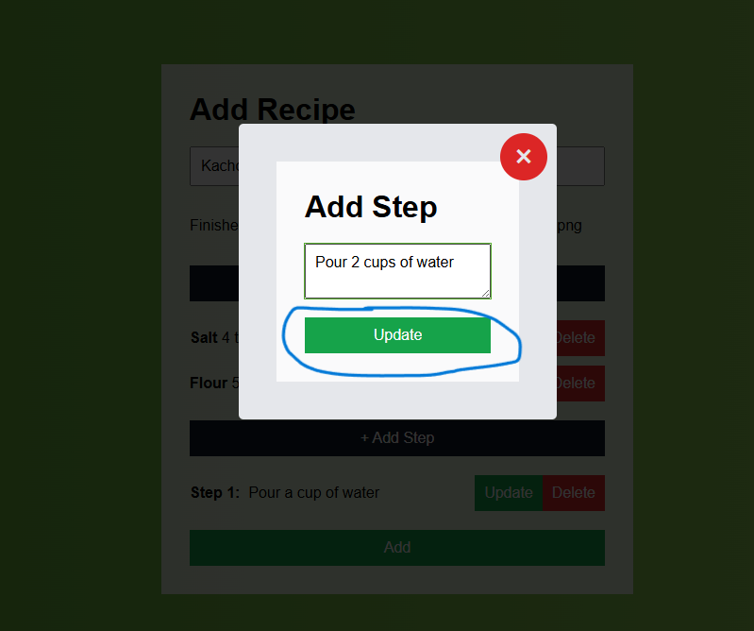

Slide 32
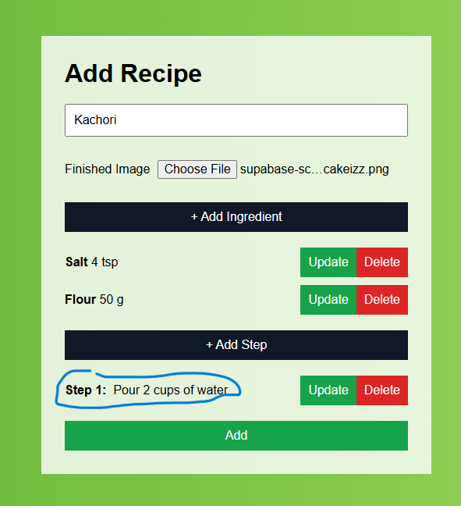

Slide 33
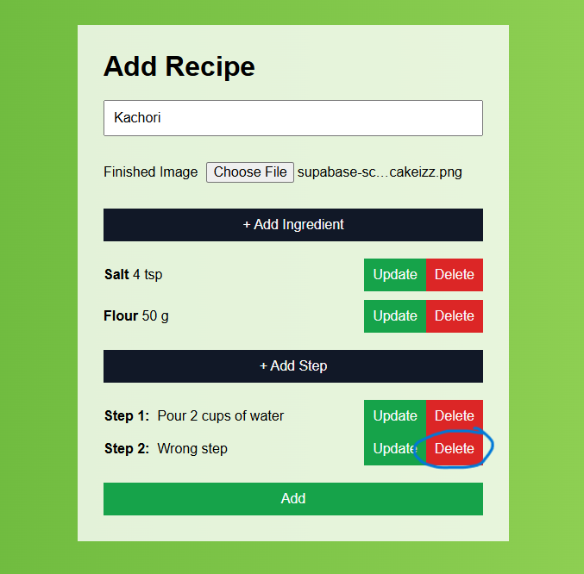
6.b. Delete a step

Slide 34
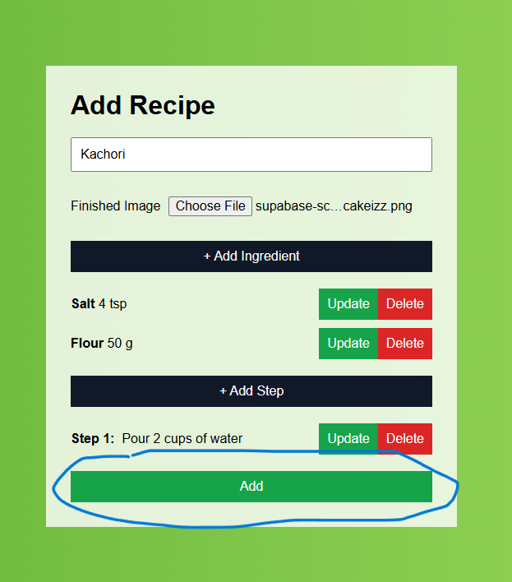
7. Submit the form and add recipe

Slide 35
AddRecipeForm component
Accepts recipe’s name, image, ingredients and steps.
Can add an ingredient by clicking add ingredient button and submitting the resulting form.
Can add a step by clicking add step button and submitting the resulting form.
Lists all ingredients/steps added, with options to delete or update each of them.
On submit, adds image to supabase, creates recipe object including image URL, adds newly created recipe to state using reducer.

Slide 36
Searching recipes
In header you can search recipe using input field.
You can search by keyword or ingredients.
By Keyword:
Accepts a keyword.
Looks for keyword in recipe's name and steps.
Case insensitive.
By Ingredients:
Accepts one or more ingredients and look for them in recipe.
Match all ingredients (recipe should have all ingredients)
Search Query: "tomato + onion + sugar"

Slide 37
Match any:
Search Query: "tomato, onion, sugar"
Just one ingredient
Search Query: "tomato"
Case insensitive
On search button click will take you to "/", with your search query in search params.
Will show filtered recipes based on your search query.

Slide 38
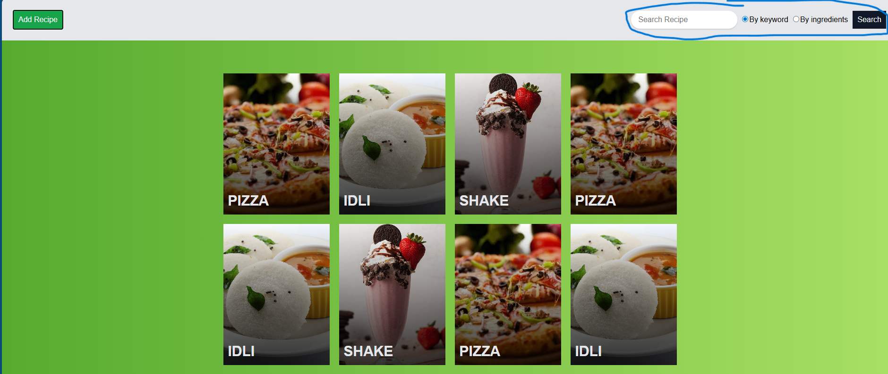
Search recipes

Slide 39
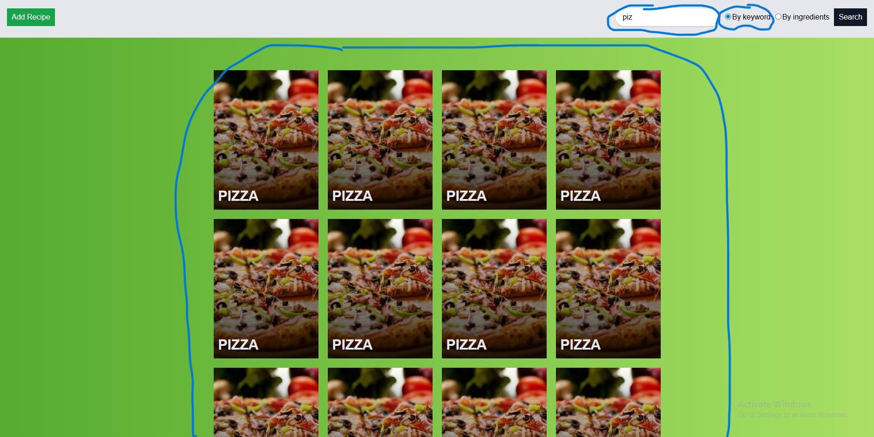
Search by keyword
Note: searchQuery: "piz", searchBy: "keyword", only pizza has "piz" in name or steps.

Slide 40
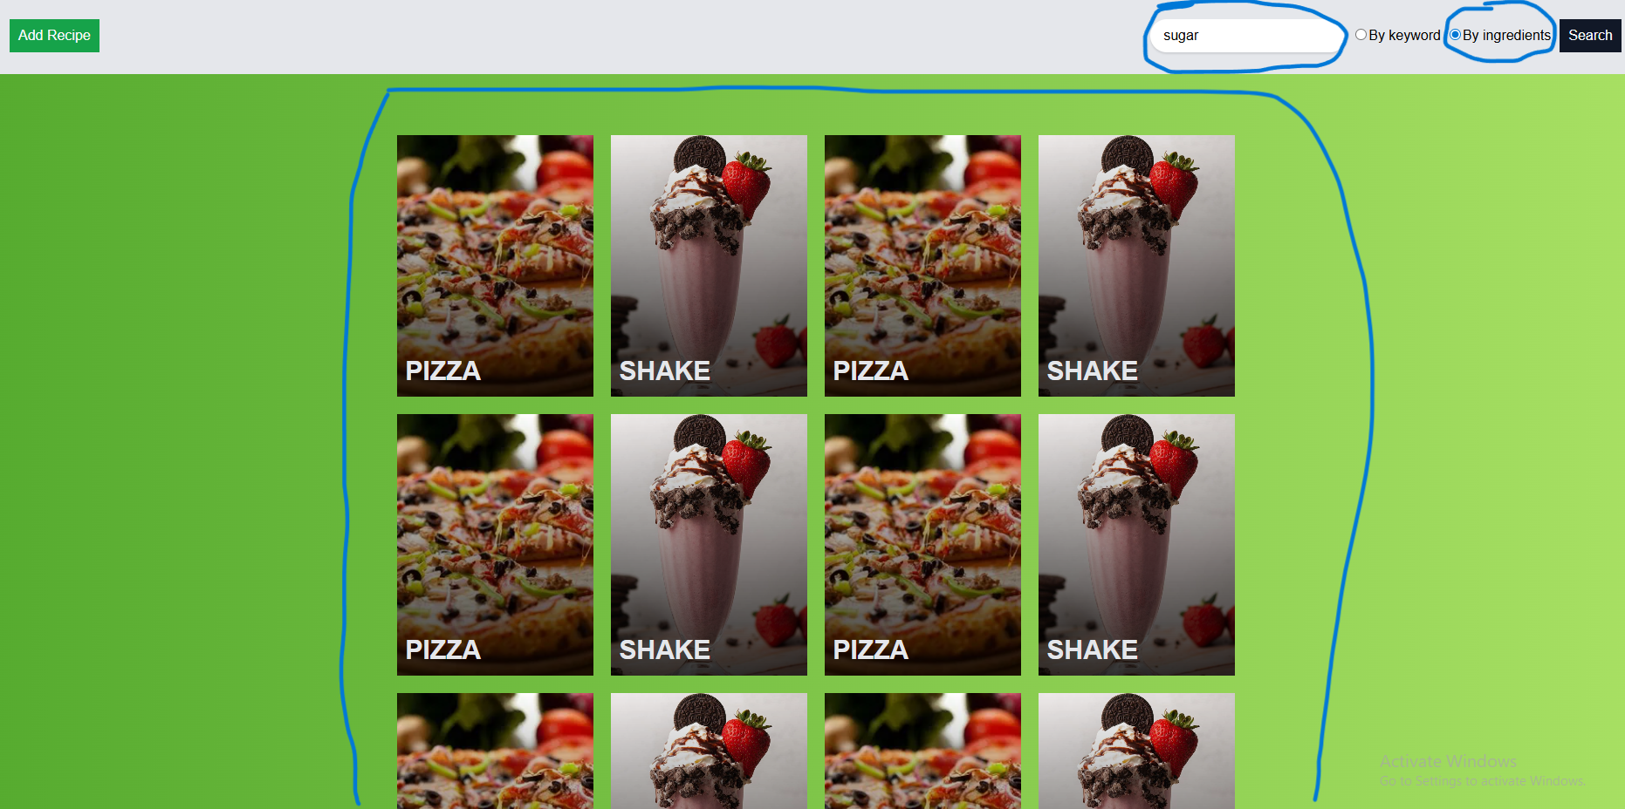
Search by one ingredient
Note: searchQuery: "sugar", searchBy: "ingredients", both pizza and shake has sugar.

Slide 41
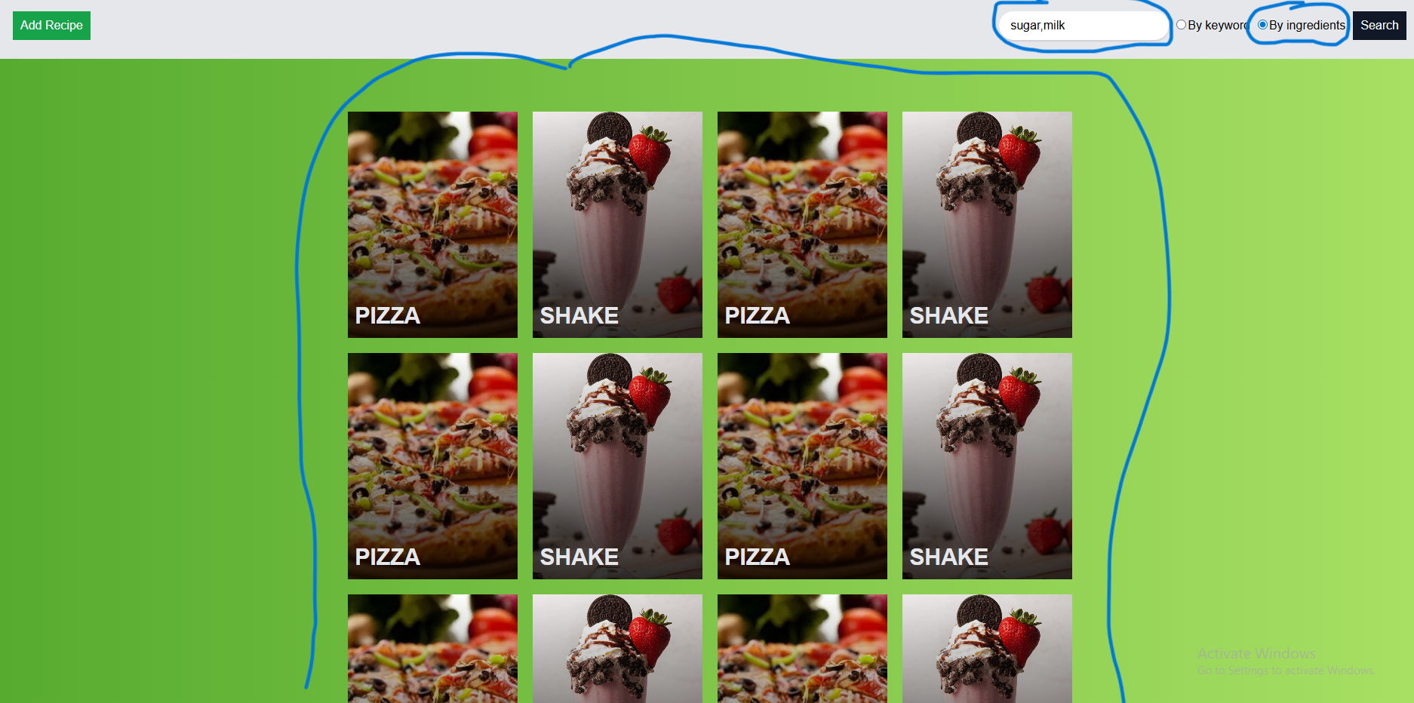
Search recipes that have at least one ingredient searched
Note: searchQuery: "sugar,milk", pizza have sugar and shake have sugar and milk.

Slide 42
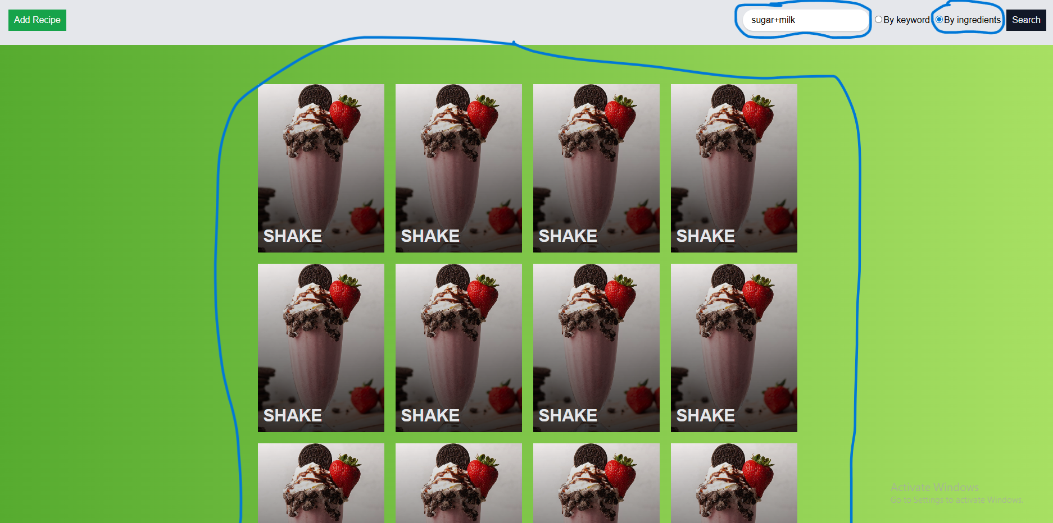
Search recipes that have all the ingredients searched
Note: searchQuery: "sugar+milk", only shake has both sugar and milk.

Slide 43
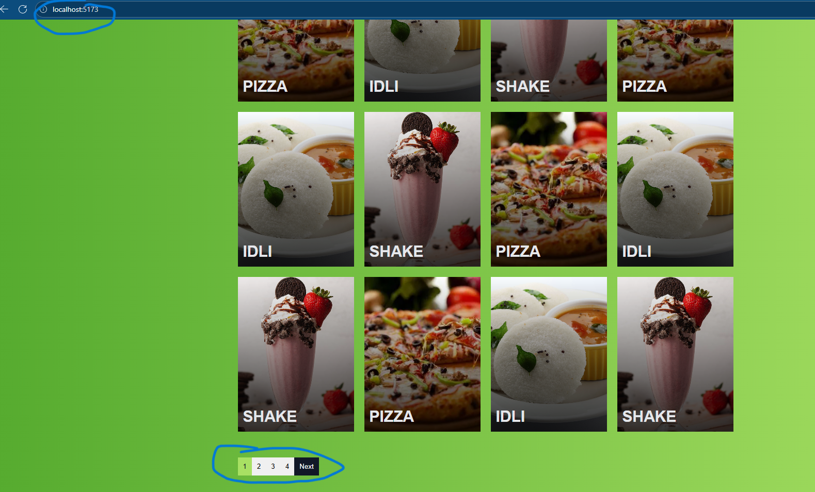
Pagination

Slide 44
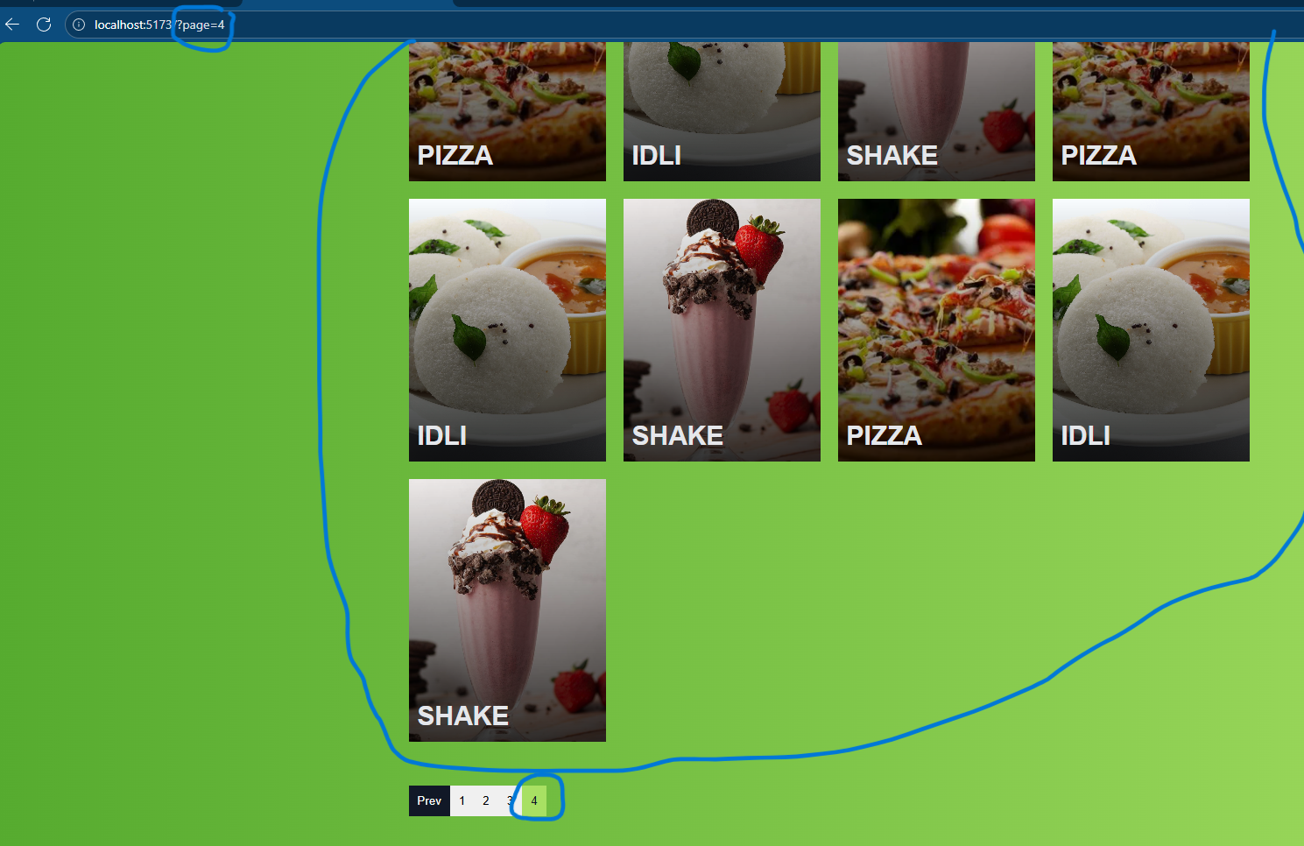

Slide 45
View recipe details
Click on "View Details" button in recipe list item.
It will take you to "/recipe/:id".
It will show you details of the recipe you just selected.

Slide 46
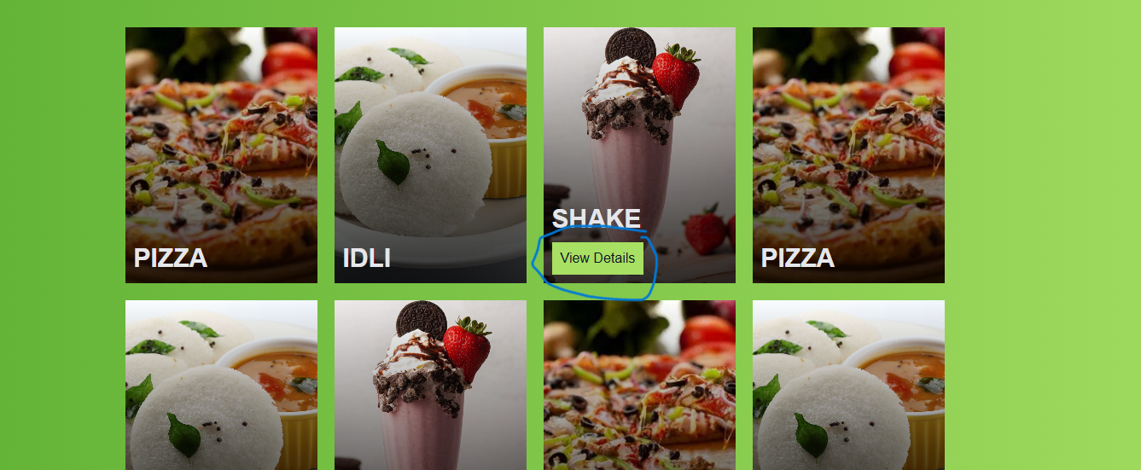

Slide 47
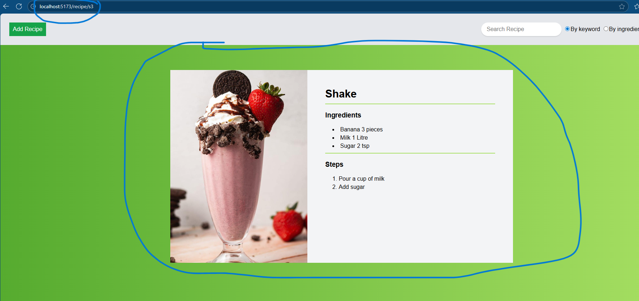

Slide 48
How app works

Slide 49
When visiting "/"
RecipesWithPagination component renders RecipeList and Pagination.
RecipeList gets searchParams(searchQuery, searchBy and page) and dispatches action to filter recipes on mount or whenever params change.
RecipeList gets recipeToView from state and display these recipes.
Pagination will reflect these changes.

Slide 50
When searching (on search form submit)
On search submit, navigates to “/” along with search query i.e.“/searchQuery=something&searchBy=keyword”.
RecipeList gets these searchParams and dispatches action to filter the recipes.
RecipeList and pagination reflects these changes.

Slide 51
Adding a recipe
User clicks "Add Recipe" button from header or visits "/addRecipe".
AddRecipeFormComponent is rendered.
It accepts recipe's name, finished image, ingredients and steps.
On submit, it adds the finished image to cloud storage (supabase).
This uploaded image's url and data from other form fields is used to make a recipe object.
This object is given as payload to "addRecipe" action and it dispatches, which then adds the recipe to our recipes in state.
User is redirected to this newly added recipe's page.

Slide 52
View recipe details
Clicking on "View Details" button on recipe list item will take you to "/recipe/:id".
RecipeDetailed component is rendered.
It gets recipe id from url and gets the related recipe object from state.
It then views recipe details using this object.

Slide 53
Pagination
Pagination component is rendered by RecipesWithPagination on "/" route.
It is given total count of filtered recipes, if there are filters, else all recipe count, as prop (totalCount) so it can display pagination buttons based upon it.

Slide 54
When a pagination button is clicked, page in search params changes, RecipeList will react to this (useEffect) and will dispatch action to filter recipes.
recipesToView will update, containing only recipes that should show on the page selected.
RecipeList shows these recipes.
Button related to the page we selected becomes active.

